Slide 1
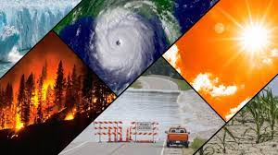
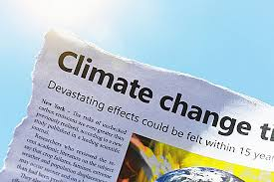
Midterm Project
CLIMATE CHANGE'S IMPACT ON APPAREL MAUNFACTURING IN CALGARY
(Red) Quoc Thach Nguyen
Franklin Anozie
LightHouse Labs
06/10/2023

Slide 2
Overview
Climate change is having a profound impact on ecosystems, economies, and industries around the world, and the production of apparel in Calgary, Canada is no exception.
Calgary, located in Alberta, is known for its cold winters, but the effects of climate change are altering the region's climate patterns and are likely to have several significant implications to produce apparels in the area.
Climate change is likely to have a multifaceted impact on the production of apparel in Calgary. The industry will need to adapt to shifting consumer preferences and changing weather patterns while also addressing sustainability concerns.
Notes:
Climate change is having a profound impact on ecosystems, economies, and industries around the world, and the production of apparel in Calgary, Canada is no exception. Calgary, located in Alberta, is known for its cold winters, but the effects of climate change are altering the region's climate patterns and are likely to have several significant implications for the production of apparels in the area.
1. Temperature Extremes:
- Warmer Winters: Calgary is known for its cold winters, which have historically driven demand for cold-weather apparel such as heavy coats, mittens, and scarves. As winters become milder due to climate change, there may be decreased demand for these items.
- Increased Summer Heat: On the flip side, summers in Calgary are becoming hotter and more unpredictable. This could lead to increased demand for lightweight, breathable clothing like shorts, t-shirts, and summer dresses. It might also lead to a greater need for sun protection apparel.
2. Seasonal Shifts:
- Alterations in seasonality can disrupt traditional apparel production schedules. Warmer falls and delayed winters may require a shift in the timing of winter apparel manufacturing, impacting production planning and inventory management.
3. Supply Chain Disruptions:
- Climate change-related events, such as extreme weather events and natural disasters, can disrupt supply chains. For instance, wildfires and flooding can damage manufacturing facilities, disrupt transportation routes, and hinder the sourcing of raw materials, all of which can affect apparel production.
4. Material Sourcing:
- Changes in climate can impact the availability and quality of materials used in apparel production. For example, fluctuations in cotton crops due to shifting climate conditions can affect the cost and availability of cotton-based textiles.
5. Sustainability Concerns:
- The fashion industry is increasingly focusing on sustainability and reducing its carbon footprint. Climate change's role in driving environmental awareness may lead to greater demand for eco-friendly and sustainable apparel options in Calgary.
6. Adaptation and Innovation:
- Apparel manufacturers may need to adapt by incorporating climate-resilient and weather-appropriate materials into their product lines. Innovations in fabric technology and design might be necessary to meet changing consumer needs.
7. Consumer Behavior:
- As Calgarians experience more variable weather patterns, their purchasing habits may evolve. Consumers may opt for versatile clothing items that can be layered for different weather conditions, influencing the types of apparel produced.
In conclusion, climate change is likely to have a multifaceted impact on the production of apparel in Calgary. The industry will need to adapt to shifting consumer preferences and changing weather patterns while also addressing sustainability concerns. To thrive in this evolving landscape, apparel manufacturers should remain agile, invest in research and development, and consider the environmental implications of their production processes. Additionally, collaborations between industry stakeholders, policymakers, and environmental organizations may be essential to ensure a sustainable future for the apparel sector in the face of climate change.

Slide 3

Goals:
Forecast upcoming weather patterns, with a specific focus on temperature trends in Calgary, Canada.
Providing valuable insights to the ABC Apparel Company to optimize its strategy for producing jackets.
To harmonize our production processes with the expected weather conditions.

Slide 4
Product Strategy
Fall Light Jackets: When the forecast indicates a temperature decline for the upcoming fall season, we will increase production of light jackets. Otherwise, a stable or rising temperatures, we will consider reducing production.
02
Spring Sweaters: If the forecast points to a temperature drop, we will implement production reductions. However, if the forecast indicates steady or increasing temperatures, we will increase sweater production accordingly.
03
Winter Jackets: temperature forecasts indicating a drop, we will boost production of winter jackets. Conversely, a stable or increase temperature forecast we either reduce or maintain the status.
01

Slide 5
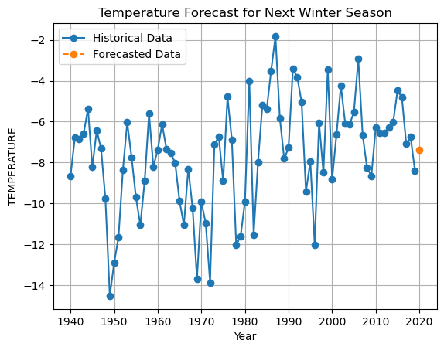

Winter

Slide 6
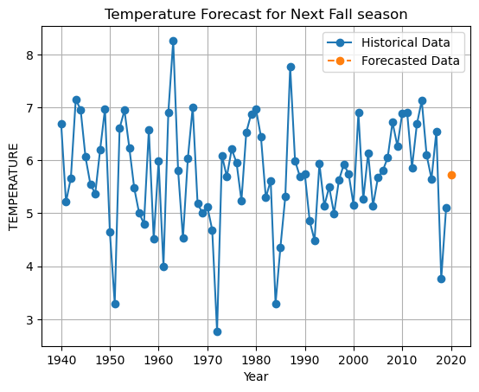
Fall

Slide 7
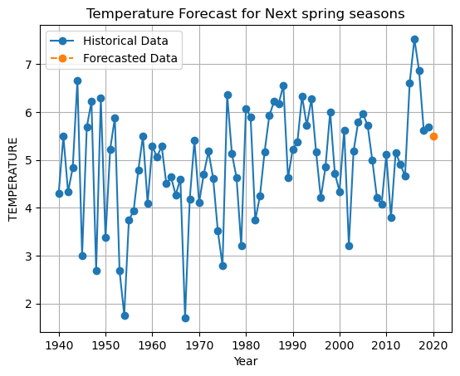
Spring

Slide 8

Results and Recommendations
Anticipated changes in temperature for the upcoming seasons are driving adjustments in our apparel production strategy:
Winter Outlook:
The forthcoming winter is projected to be milder, evident in the temperature increase from -8.4°C in 2019 to -7.4°C in 2020. In response to this shift, we plan to increase the production of winter jackets to meet potential demand for lighter cold-weather wear.
Spring Projections:
Spring temperatures are forecasted to experience a slight dip, decreasing from 5.7°C in 2019 to 5.5°C in 2020. Given the relatively stable demand, we intend to maintain current production levels for spring apparel.

Slide 9
Results and Recommendations
Fall Expectations:
Fall temperatures are expected to rise, shifting from 5.1°C in 2019 to 5.7°C in 2020. To align with this changing climate pattern, we are considering a reduction in production by 20% to optimize resources while meeting market needs effectively.
These adjustments aim to ensure that our production strategy remains in sync with evolving weather conditions and customer preferences.

Slide 10

Questions

